Slide 1
Cryvesto 2.0

Slide 2
REQUIREMENTS
Each project group will prepare a formal 10-minute presentation that includes the following:
An executive summary of the project and project goals. (5 points)
Explain how this project relates to fintech and machine learning.
The selected model. (5 points)
Describe the machine learning model that your group selected and why.
The data preparation and model training process. (3 points)
Describe the source of your data and why you chose it for your project.
Describe the collection, cleanup, and preparation process.
Describe the training process.
The approach that your group took to achieve the project goals. (5 points)
Include any relevant code or demonstrations of the machine learning model.
Describe the techniques that you used to evaluate the performance of the model.
Discuss any unanticipated insights or problems that arose and how you resolved them.
The results andconclusions from the machine learning model or application. (5 points)
Include relevant images or examples to support your work.
If the project goal wasn’t achieved, share the issues and what the group tried for resolving them.
Next steps. (2 points)
Take a moment to discuss the potential next steps for the project.
Discuss any additional questions that you’d explore if you had more time. Specifically, if you had additional weeks to work on your project, what would you research next?

Slide 3
Executive Summary
Explain how this project relates to fintech and machine learning.

Slide 4
The data preparation
SOURCES OF DATA – considered and used
TWITTER
REDDIT
WALL STREET JOURNAL
NEWSApi
APIs Considered
TextBlob
NLTK (USED)
Augmento (USED)
Twitter
NewsAPI (USED)
Yahoo Fin
Alpaca Trade API

Slide 5
The Model
MODELS ANALYZED
Logistic Regression
SVC
Adaboost (RECOMMENDED – better and consistent predictability for both signals)
Random Forest
Neural Networks – gave very unpredictable results
SIGNAL Strategy
Simple strategy – (KISS works!)
Strategy combining differing levels of sentiment polarity to determine signals
SMA Short/Long – SMA of sentiments and not daily returns

Slide 6
The approach that your group took to achieve the project goals. (5 points)
Ran the models and compared the classification reports and the cumulative returns
Problems anticipated – to tame the model
Changes in Signal strategy
Tried many runs with different configurations
Tried many Neural Network runs
Tedious to change the parameters and record and evaluate.. Finally converted the reporting and charting using Pandas, simplifying the process
Wsj has no crypto specific data
Augmento has crypto specific sentiment but not the twitter//reddit data
NewsApi is like WSJ. The good part is we can do the analysis we want. Tweak the NLP strategy as we deem fit…not-so-good part is. That it has lacks specific crypto data

Slide 7
The results and conclusions from the machine learning model or application. (5 points)
Include relevant images or examples to support your work.
If the project goal wasn’t achieved, share the issues and what the group tried for resolving them.

Slide 8
Next steps. (2 points)
Take a moment to discuss the potential next steps for the project.
Discuss any additional questions that you’d explore if you had more time. Specifically, if you had additional weeks to work on your project, what would you research next?

Slide 10
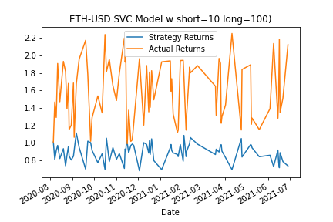
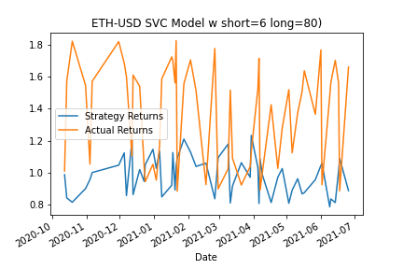
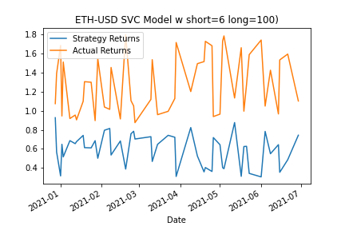
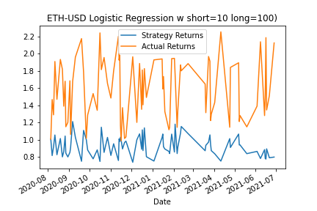
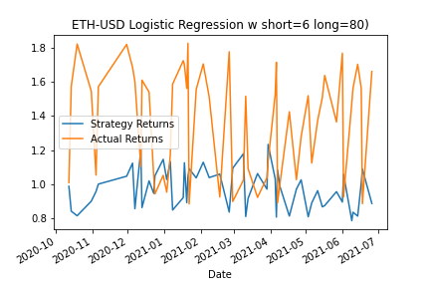
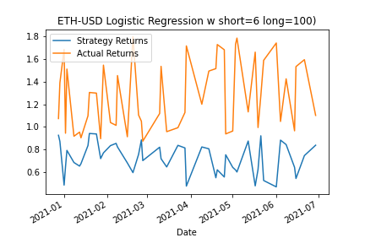

Slide 11
